Slide 1
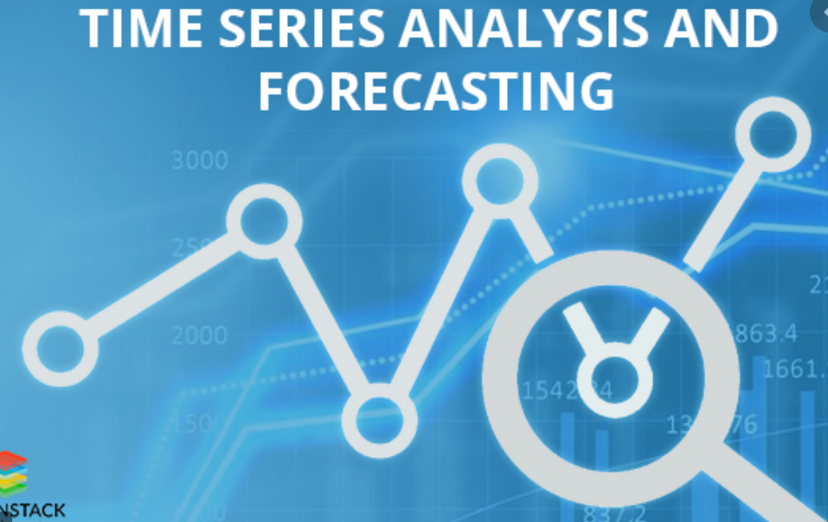
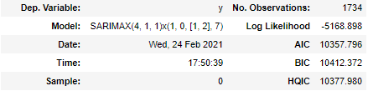

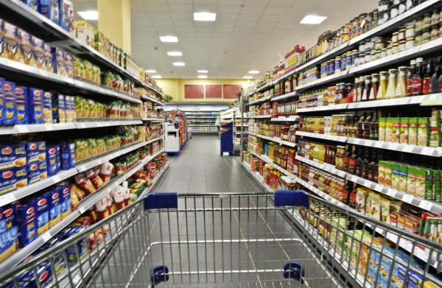
Sales Demand Prediction in retail using Time Series forecasting
Monica Nino Joya
11th March 2021

Slide 2
Agenda
BIO
Project Context
Industry / Domain
Problem area / statement
Stakeholders
Data & Design
Data Source
Data exploration, analysis and visualisation
Overall flow used
Deliver
Machine models
Model Evaluation
Conclusions and next steps

Slide 3
Biography
Education
Bachelor of Industrial Engineer
Diploma of Database Design and Development
Project Management Certificate Program
Professional experience
Service Analyst – Woolworths Group
Technology Services Coordinator – Sydney Airport
Data science learnings and experience
Data Science & AI Certificate - Current
Python for Data Analytics
Relevance to the project
Experience in the retail Industry

Slide 4
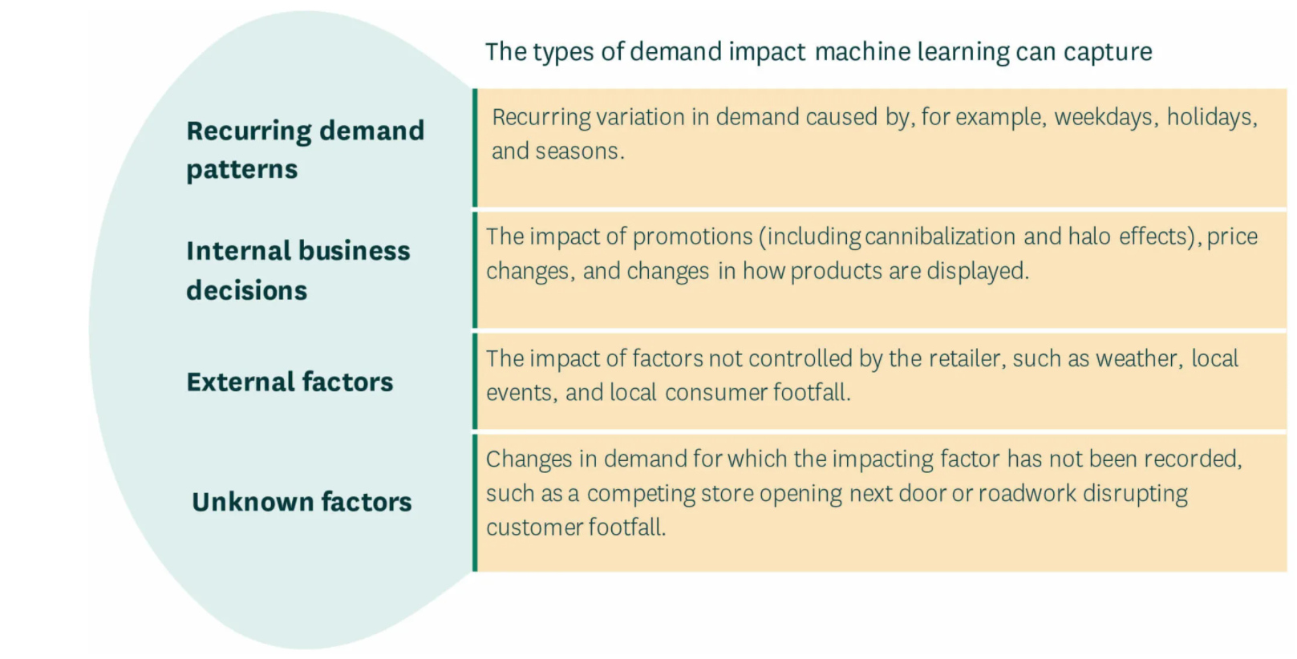
Project Context
Background
In retail, margins are thin, and competition is fierce. Every decision affects current and feature performance.
Demand forecasting to improve customer service, productivity and stay ahead of competitors.
Demand Forecasting: How much of a product customers will want to purchase during time period according to historic information.
Leverage Machine Learning for Demand Forecasting

Slide 5



Project Context
Problem areas to solve with demand forecasting
Inventory Management
Ideal levels of product = Happy Customers
Less stock on hand = lower holding costs
Labour productivity
Optimal level of staff = improve Cost of labour.
Marketing
Plan marketing campaigns = increase revenue
Stakeholders
Replenishment, marketing, and Customer Service team, Clients
Business Question: Can we create a machine leaning model to predict sales demand for the next three months that can help to solve the three problem areas?
Data Question: By using historical data, can we predict sales demand for the next three months ?

Slide 6
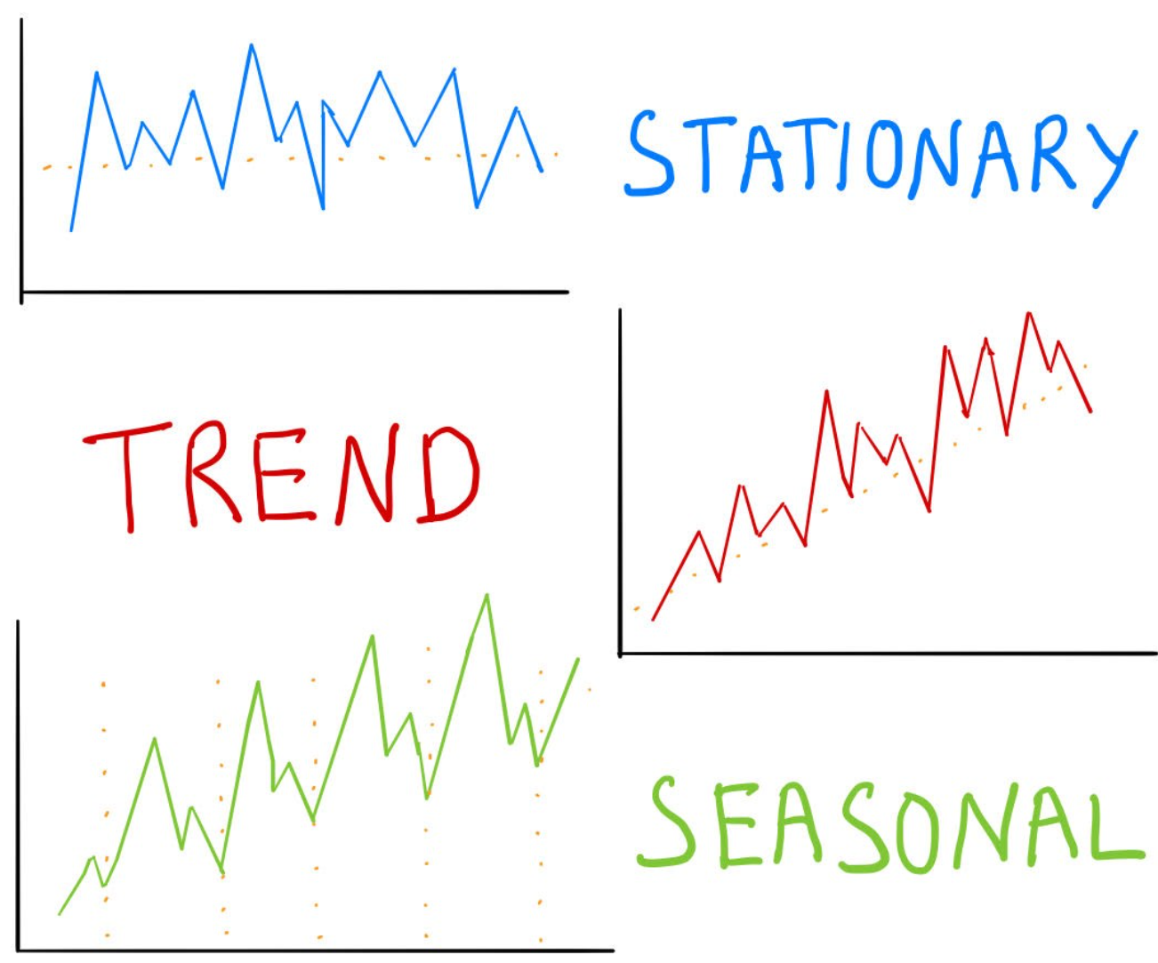
What is Time Series?
A time series is a sequence of observations taken sequentially in time. The goal is to predict future, based on the past observational data.
Characteristics of time series:
Seasonality: Periodic fluctuations over time. Trend: data Increase or decrease over time. Noise/residual: Unexplained variance/volatility of the time series. Stationarity: Statistical properties do not change over time. Autocorrelation: Correlation between a time series and a delayed copy of itself. Note: Model them well to obtain accurate forecast.

Slide 7






Overall Process Flow Used
Identify Business Question
Explore Data
Build Model and evaluate
Identify Data Question
Implement model and make decisions
Feature Engineer

Slide 8
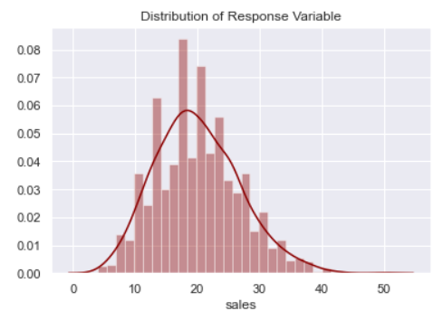
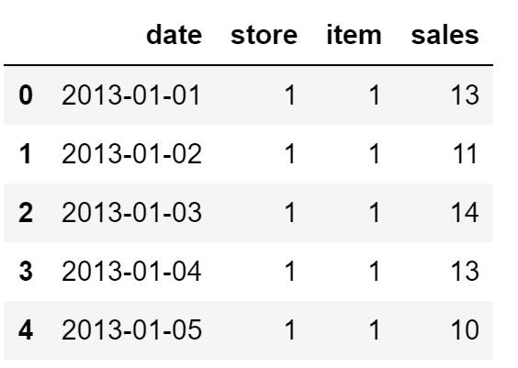
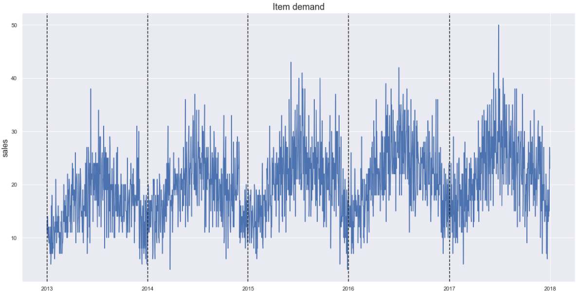
DATA
Walmart Case Study acquired from Kaggle Forecasting Challenge.
Dataset contains 5 years of daily sales volumes. Predict 3 months.
Train Data
Test Data
Last 3 months

Slide 9
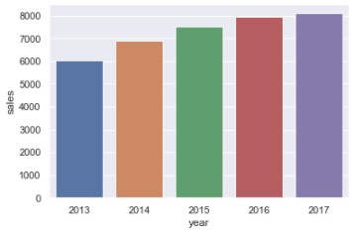
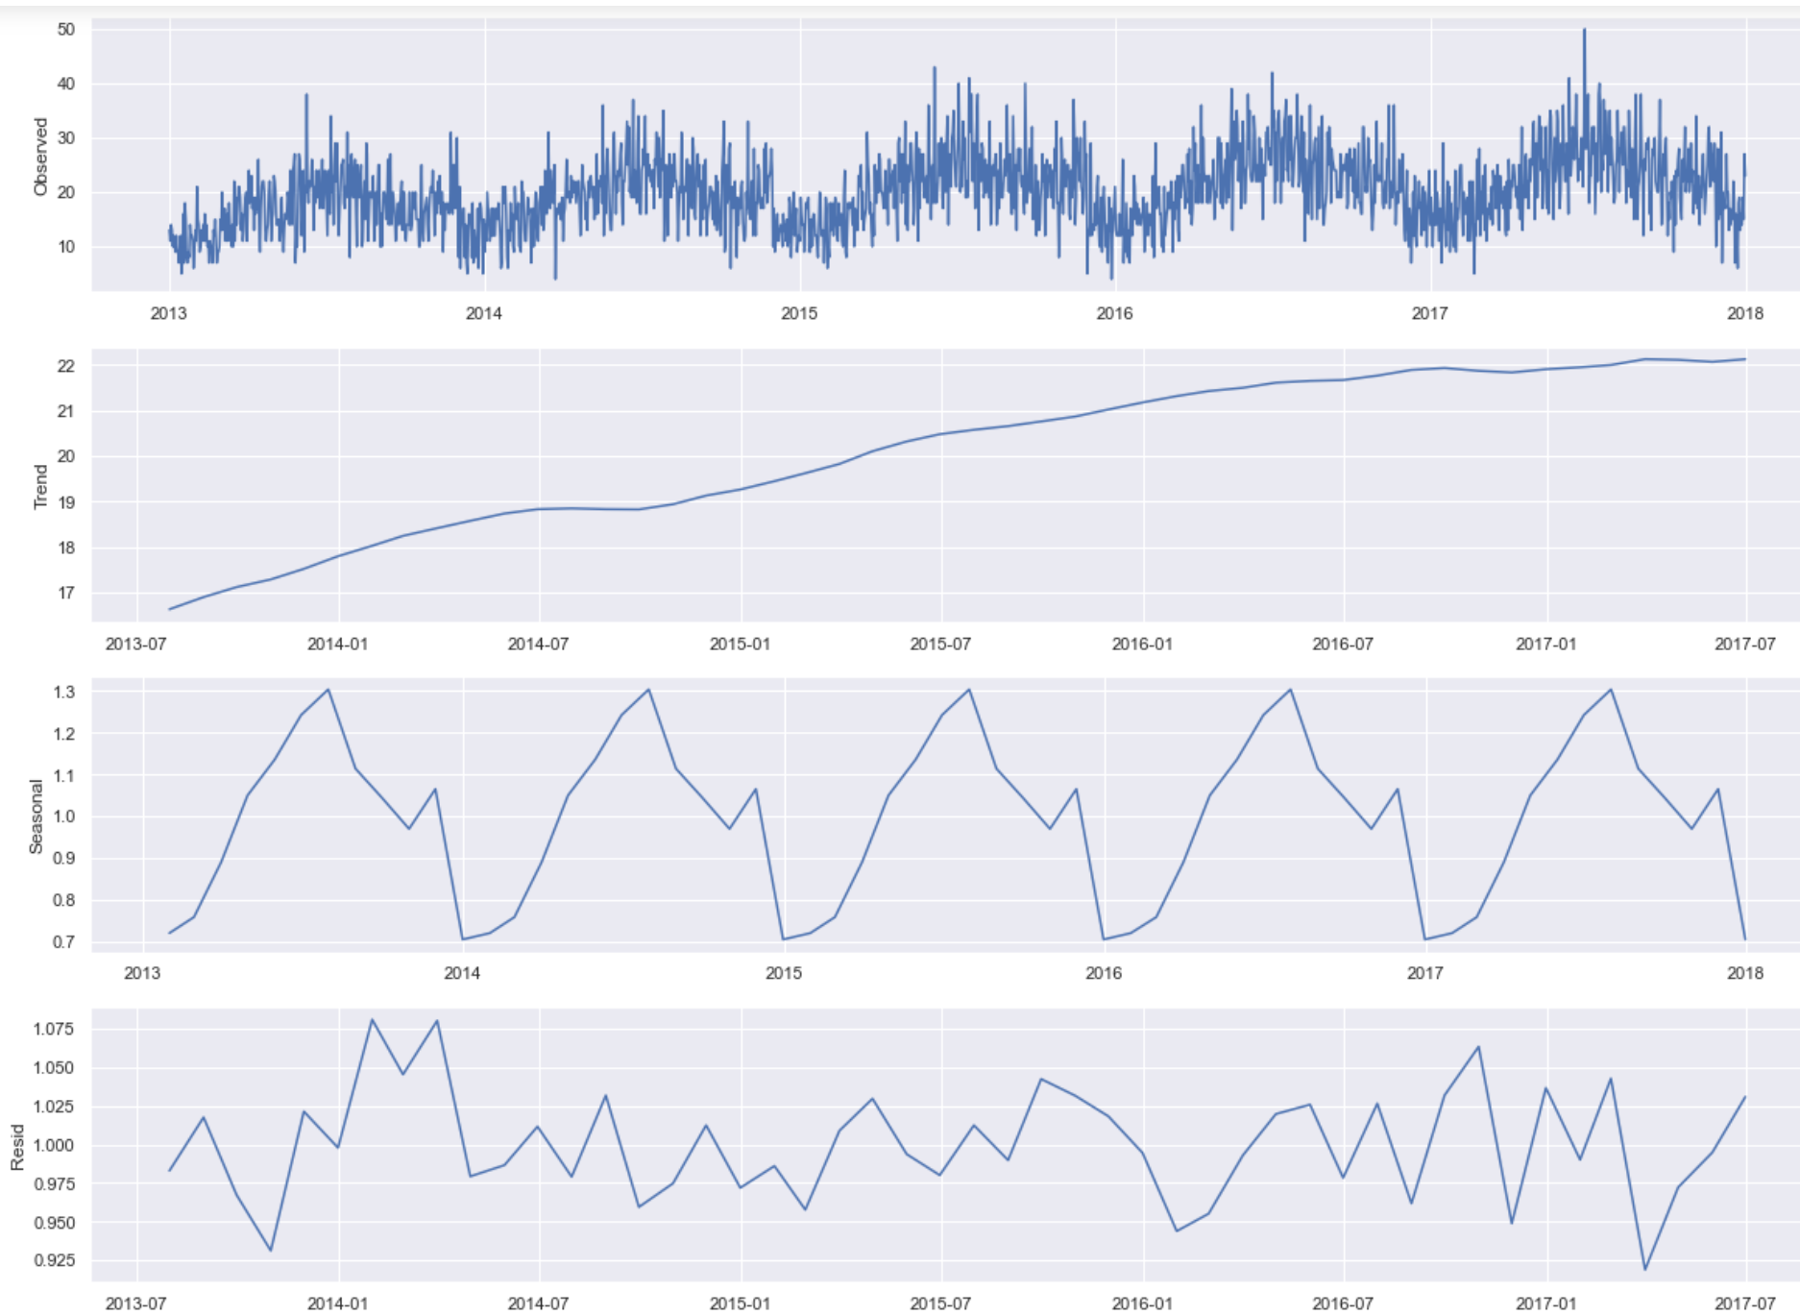
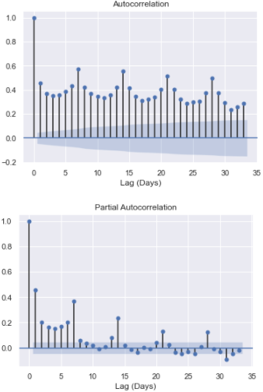
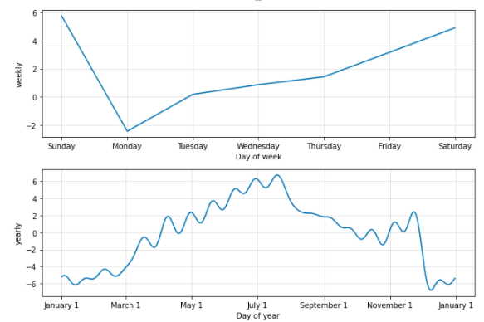
Explore Data
Analysis of Time series Characteristics
Decomposed results: Weekly, yearly, monthly for seasonal pattern.
Sales peak: Jun to July and Dec decrease Sep-November.
Sales are slightly increasing over the years.
From ACF seasonal component repeats every 7-time steps.
Trend
Seasonal
Residual

Slide 10
Models Used for Time Series Forecasting
ARIMA
SARIMA
SARIMAX
Prophet

Slide 11
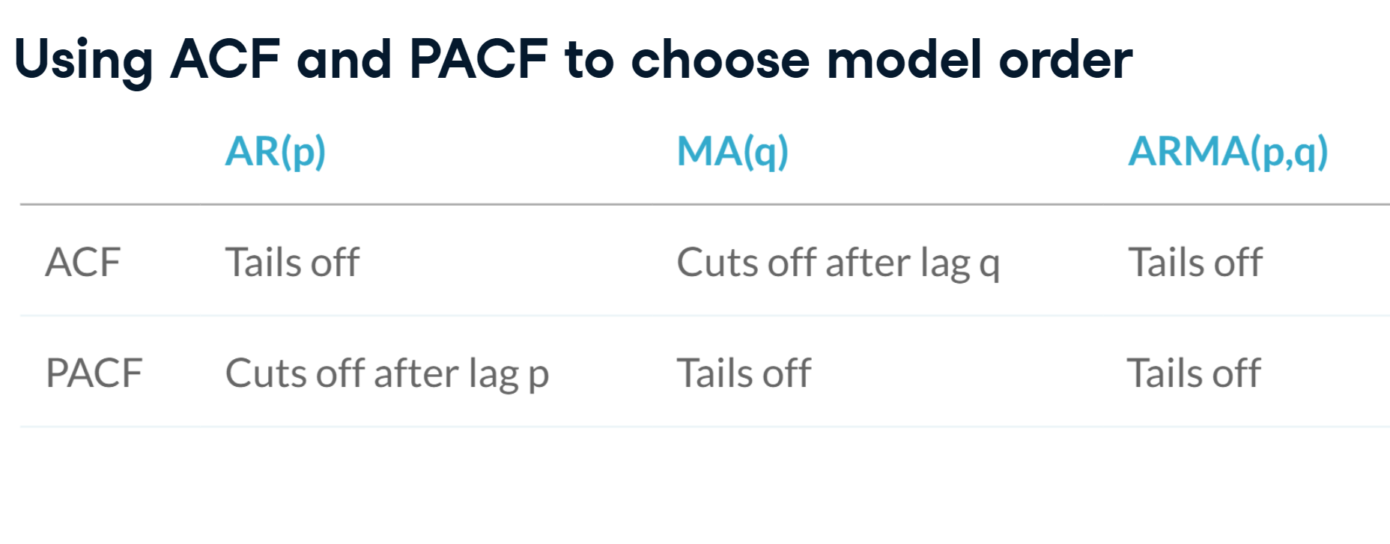
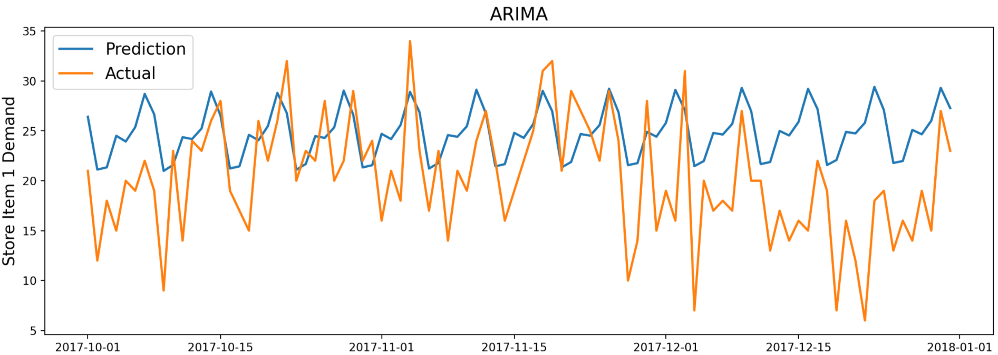
Models Used
ARIMA
Auto Regressive Integrated Moving Average model
Parameters:.
d: Differencing to remove trend and seasonality
q= MA(Moving Average).
From autocorrelation 1st guess(1,1,0) and then lower AIC (6,1,1)
p= AR(Auto Regressive). use lagged values of the target variable as X variables
AIC: For model selection. Estimator of prediction error

Slide 12
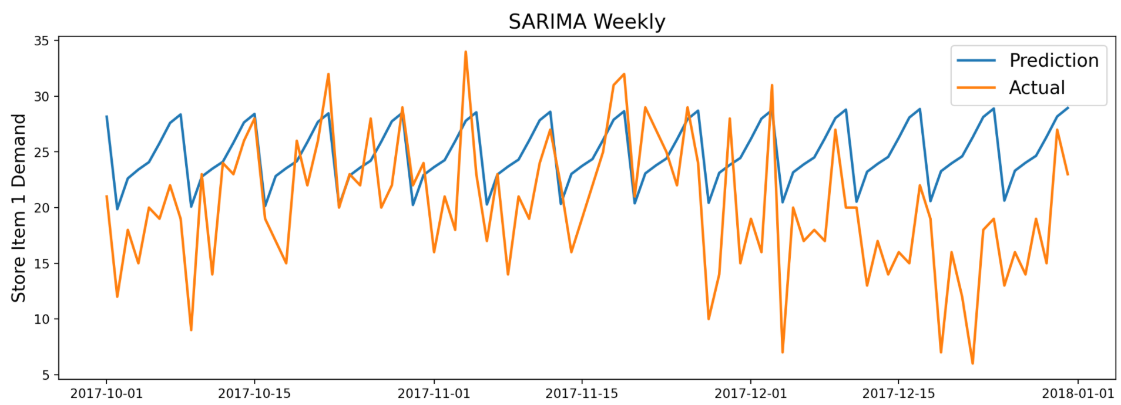
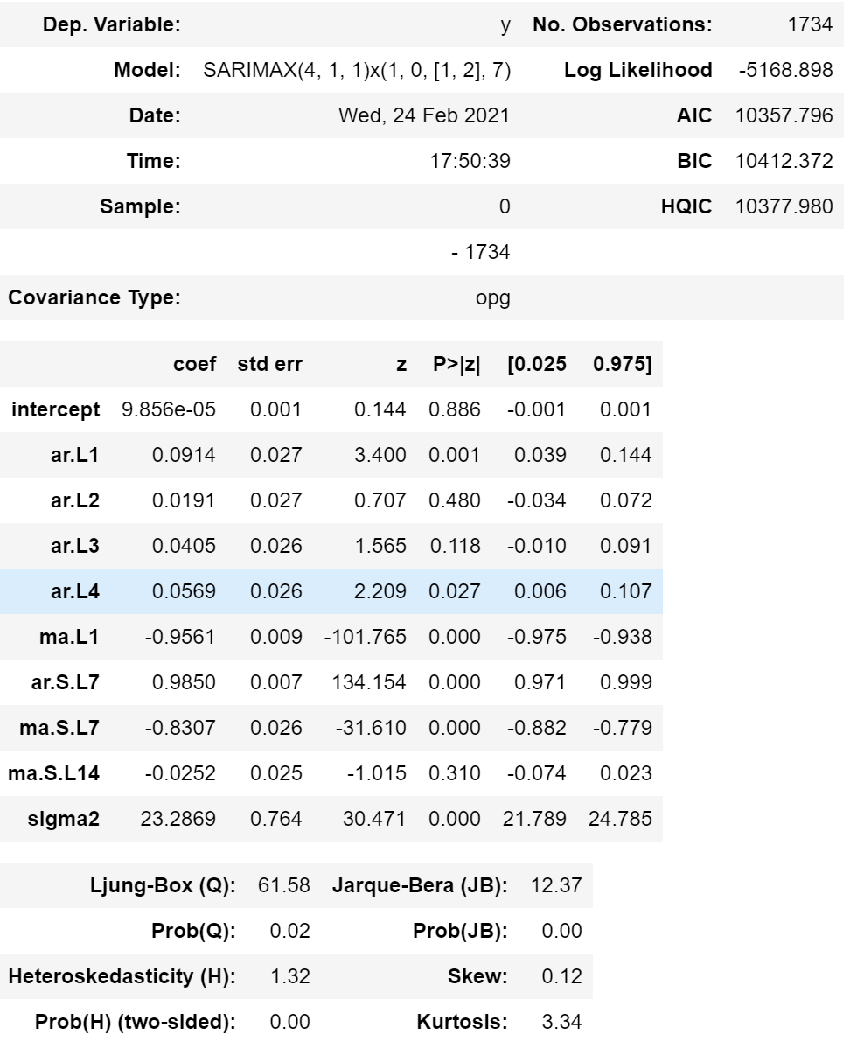
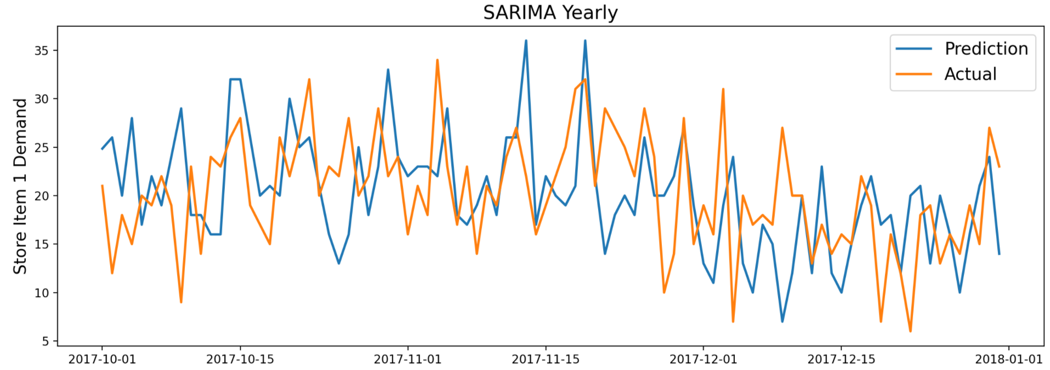
Models Used
SARIMA
ARIMA + Seasonal component
pmdarima for hyperparameter optimization (order = (4,1,1), seasonal order = (1,0,2,7))
Two variation: Yearly & Weekly seasonality

Slide 13
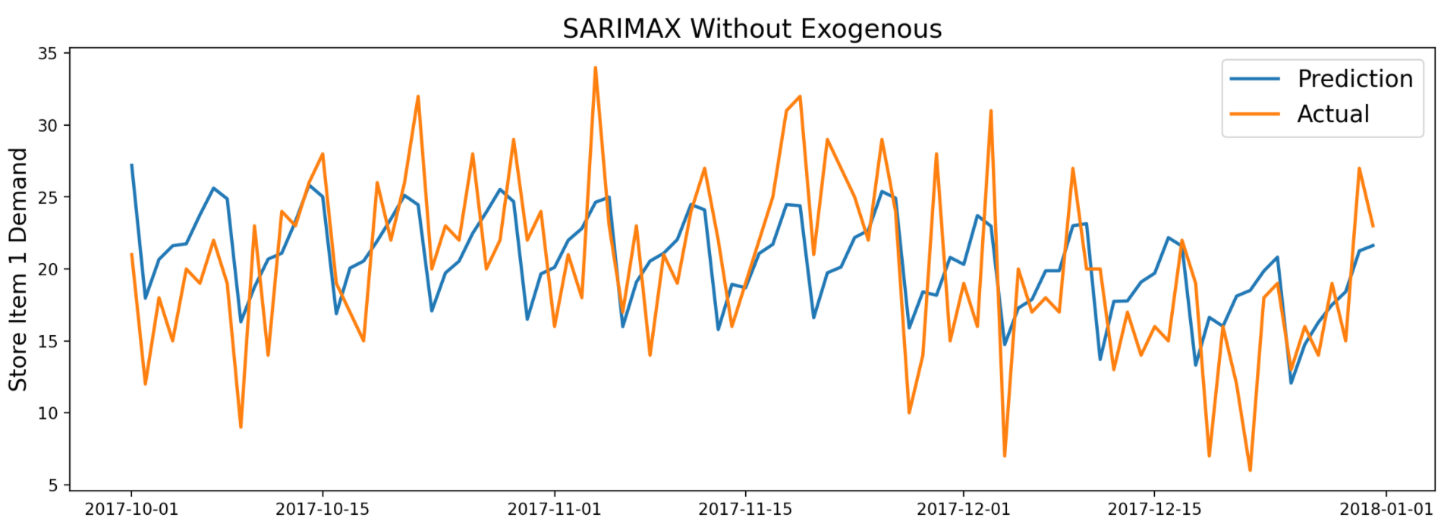
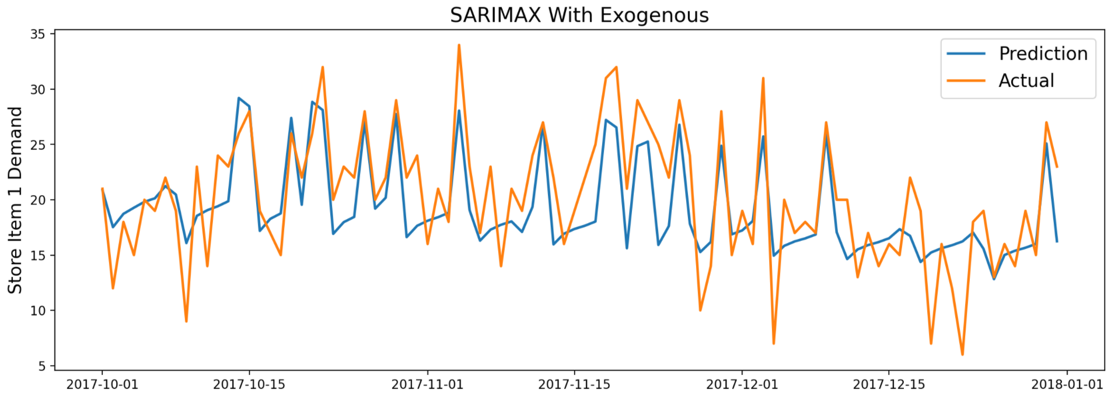
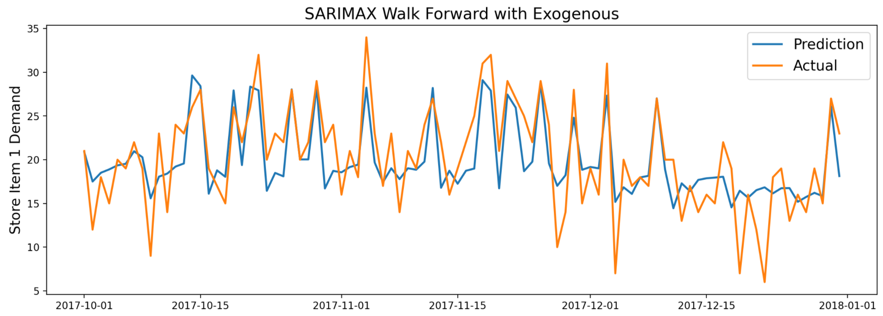
Models Used
Exogenous variable: Parallel time series not modelled directly but used as a weighted input to the model (E.g., Additional seasonality, holydays, Events..)
SARIMAX
SARIMA with Exogenous Variables:
SARIMA +
Weekly seasonal component + exogenous variables (Yearly(Fourier terms), holidays, event)
Variation: Walk forward validation
Fourier series is a way of representing a periodic function as a sum of sine and cosine functions

Slide 14
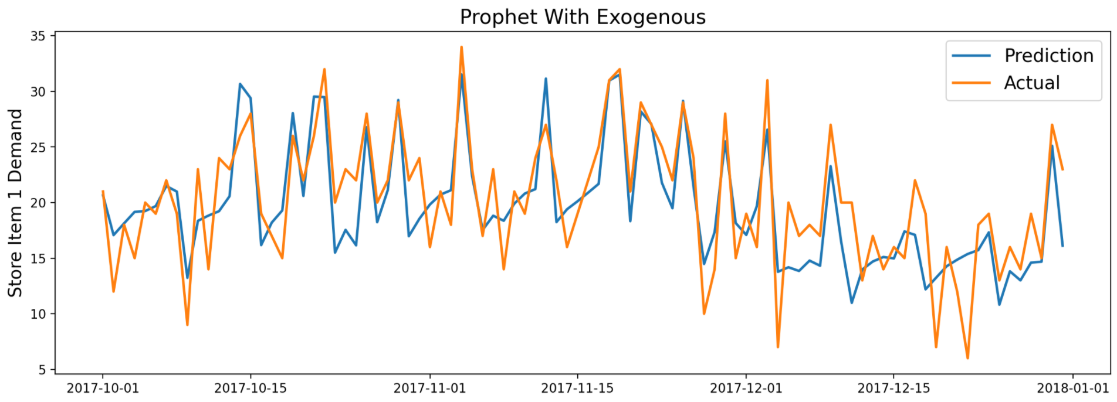
Models Used
Prophet
Prophet is released by Facebook.
- Built with multiplicative decomposition
- Fit with Exogenous variables (holidays and special events effects).
- Added seasonality with Fourier order: yearly, weekly, quarterly, biweekly, 3weeks( PACF Plot)

Slide 15
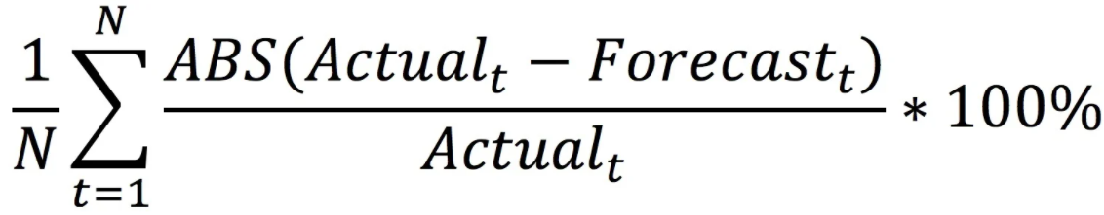
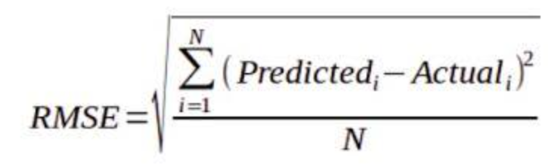
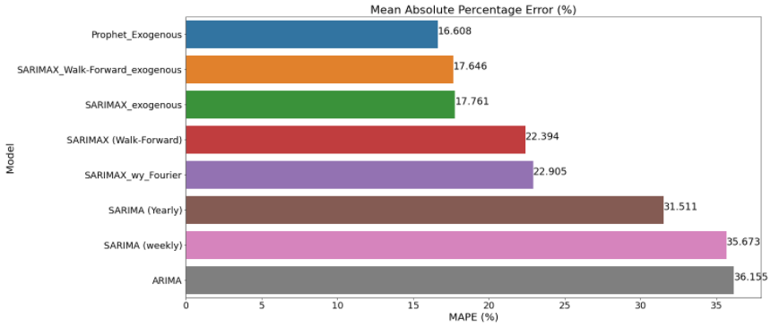
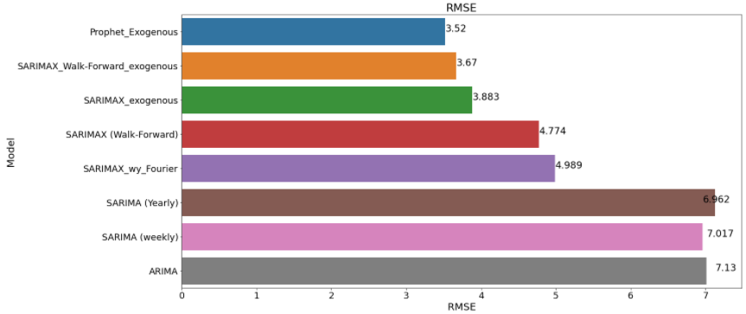
Models Evaluation- Metrics
MAPE (Mean absolute percentage error): Express accuracy as a percentage of the error
RMSE (Root Mean Square Error): Standard deviation of the residuals (prediction errors).
Best Model:
Prophet is showing the best results with MAPE 16.6% and RMSE 3.52

Slide 16

Conclusions and Next Steps
Conclusions
Best performance model for this case study is Prophet with MAPE 16.6% and RMSE 3.52.
Exogenous variables incorporated in the model increased performance and forecasting accuracy.
By implementing a time series model using historical data, we were able to predict future demand which plays a key role in planning and optimization and helps to guide business decisions.
Next steps
Analyse other external factors that can influence and improve the performance of the model.
Retrain the model with new data and automate this process to generate a weekly sales demand forecast report that will be distribute to Stakeholders identified for decision making.

Slide 17
References
Rob J Hyndman, “Forecasting Principles and Practice” https://otexts.com/fpp2/
ARIMA Model – Complete Guide to Time Series Forecasting in Python” https://www.machinelearningplus.com/time-series/arima-model-time-series-forecasting-python/
Jason Brownlee. “What Is Time Series Forecasting?” Machine Learning Mastery. Aug 15, 2020. https://machinelearningmastery.com/time-series-forecasting/
Andrej Baranovskij, “Forecast Model Tuning with Additional Regressors in Prophet” Jul 16, 2020. https://towardsdatascience.com/forecast-model-tuning-with-additional-regressors-in-prophet-ffcbf1777dda

Slide 18



